Slide 1

Title:
INTEGRATED BANKING AND PAYMENT APPLICATION
Student Name: R .Pravalika
Student ID: 2520030402)
Cluster:2
Section: 7
Under the Guidance
of
Supervisor Name: Pavithra
Assistant Professor
Department of CSE

Slide 2
Abstract
The Integrated Banking and Payment Application is a web-based financial management platform designed to simulate multiple banking services within a single system.
The application provides features such as loan application and analysis, EMI calculation with graphical representation, UPI payment generation, currency conversion, smart calculator functionality, and an AI-based banking assistant.
The system begins with a secure login interface and language selection, improving accessibility for users. It includes a loan eligibility analysis module that compares interest rates from different banks and calculates EMI using standard financial formulas. The application also estimates loan approval probability based on credit score and co-applicant information, displaying results through an eligibility meter and comparison table.
Additional features include a UPI payment generator, a currency converter for exchange calculations, and an EMI calculator integrated with Chart.js for graphical visualization of payment trends. The built-in AI banking assistant helps users identify the best loan options based on interest rates. Overall, the project demonstrates the integration of HTML, CSS, and JavaScript to build an interactive, user-friendly, and feature-rich digital banking simulation system, helping users understand modern banking functionalities and financial decision-making.

Slide 3
Existing System
In the existing banking environment:
Loan comparison is difficult for users.
EMI calculations require manual tools.
Financial services are spread across different platforms.
Users must visit multiple websites for banking utilities.
No single platform provides loan analysis, EMI visualization, and financial tools together.

Slide 4
Proposed System
The proposed system provides a single integrated platform for multiple banking services.
Features include:
Loan eligibility analysisentation
UPI payment generator
EMI calculator with graphical repres
Currency converter
Smart calculator
AI banking assistant
Benefits:
Easy financial analysis
User-friendly interface
Faster loan comparison
Better financial decision making

Slide 5
System Architecture
User Interface Layer
HTML
CSS
Web UI Components
⬇
Application Logic Layer
JavaScript
Loan Analysis Algorithm
EMI Calculation
Currency Conversion
Chatbot Logic
⬇
Data & Visualization Layer
Chart.js Graphs
Bank Interest Rate Data
Local Storage

Slide 6
Project Modules
The system contains the following modules:
Login Module User authentication Local storage session
Language Selection Module Multiple language options
Loan Application Module Loan type selection Credit score analysis
Loan Comparison Module Bank interest comparison EMI calculation
EMI Graph Module Chart.js graphical visualization
UPI Payment Module Generates payment link
Currency Converter Exchange rate conversion
Smart Calculator Arithmetic operations
AI Banking Assistant Suggests best loan options

Slide 7
Objectives
The objectives of the project are:
To design a web-based banking simulation system.
To implement loan eligibility analysis.
To calculate EMI using financial formulas.
To provide graphical visualization of EMI payments.
To integrate multiple financial tools into one platform.
To improve understanding of digital banking services.

Slide 8
Co’s Attainments - FWD
CO1 – Internet Fundamentals & HTML/CSS Basics
Implemented using HTML structure (<!DOCTYPE>, <header>, <section>, <input>, <button>) and CSS styling (colours , fonts, margins, padding, CSS variables) to design the login page, loan form, and dashboard UI.
CO2 – Forms, Semantic HTML & Advanced CSS
Implemented using HTML forms (<input>, <select>, <option>, <button>) and semantic tags (<header>, <section>). Advanced CSS features like Grid layout, hover effects, transitions, and responsive viewport meta tag are used.
CO3 – JavaScript Programming Essentials
Implemented using JavaScript functions, conditions, loops, arrays, and objects for loan analysis, EMI calculation, currency conversion, calculator operations, and chatbot logic.
CO4 – JavaScript Interactivity, DOM & Storage
Implemented using DOM manipulation (document . query Selector , inner HTML), event handling (onclick), local Storage for login session, and try–catch exception handling. Chart.js is used to display the EMI graph.
CO5 – Advanced Web Development & Optimization
Implemented using SEO meta tags, Content Security Policy for security, lazy loading images for performance, and development of a fully functional responsive banking web application.

Slide 9
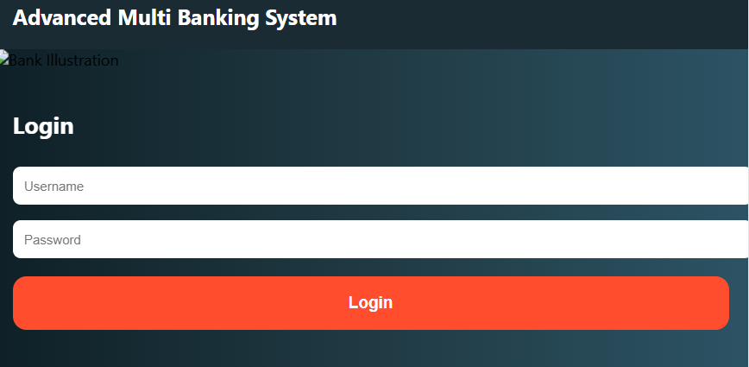
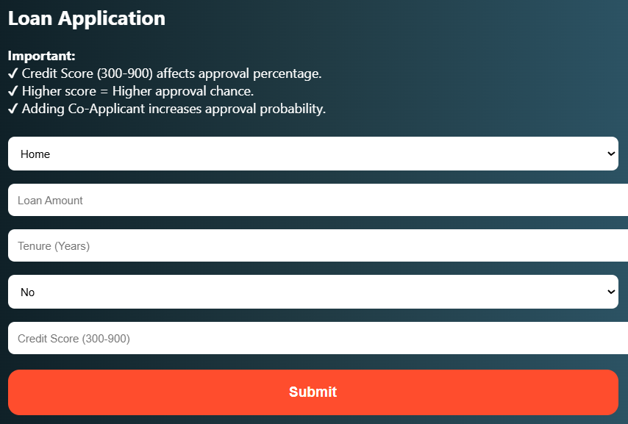
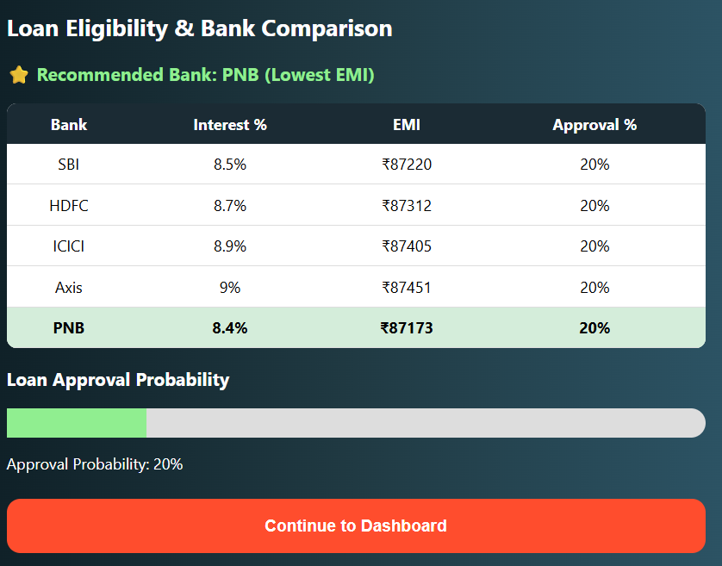
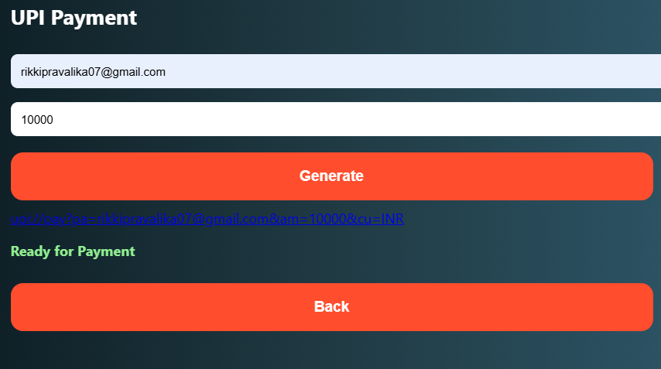
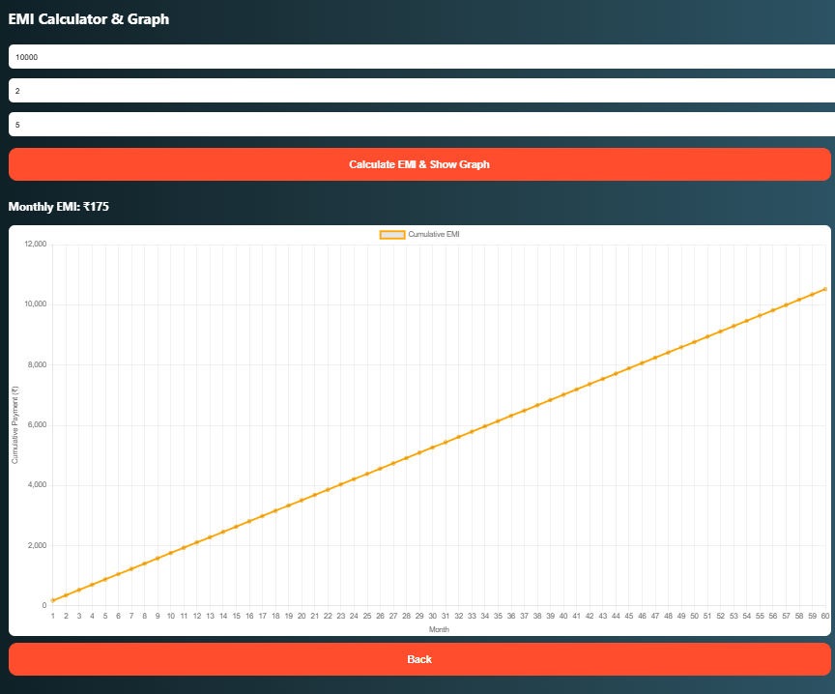
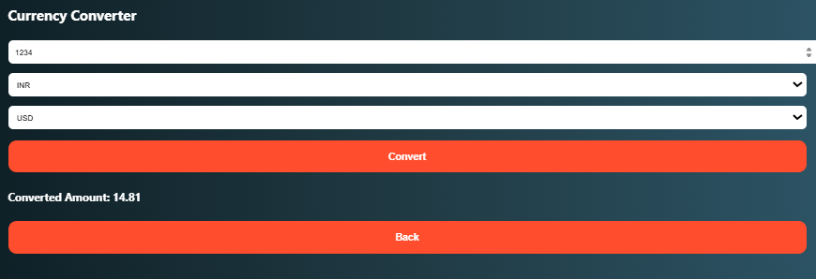
Screenshots for FWD

Slide 10
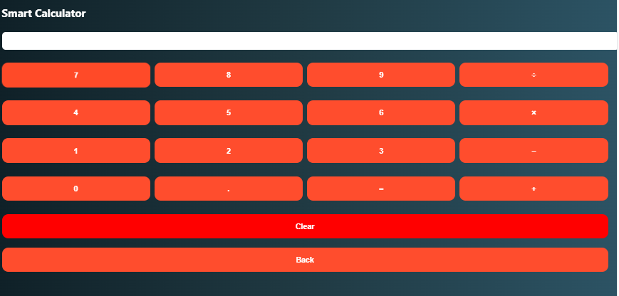
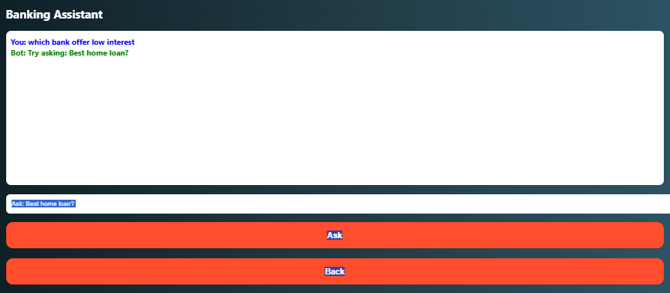

Slide 11
Conclusion
The INTEGRATED BANKING AND PAYMENT APPLICATION successfully demonstrates the development of a financial web application using HTML, CSS, JavaScript, and Chart.js.
The system integrates multiple banking utilities including loan analysis, EMI calculation, payment simulation, and financial tools.
This project helps users understand modern digital banking systems and financial decision making through an interactive and user-friendly interface.

Slide 12
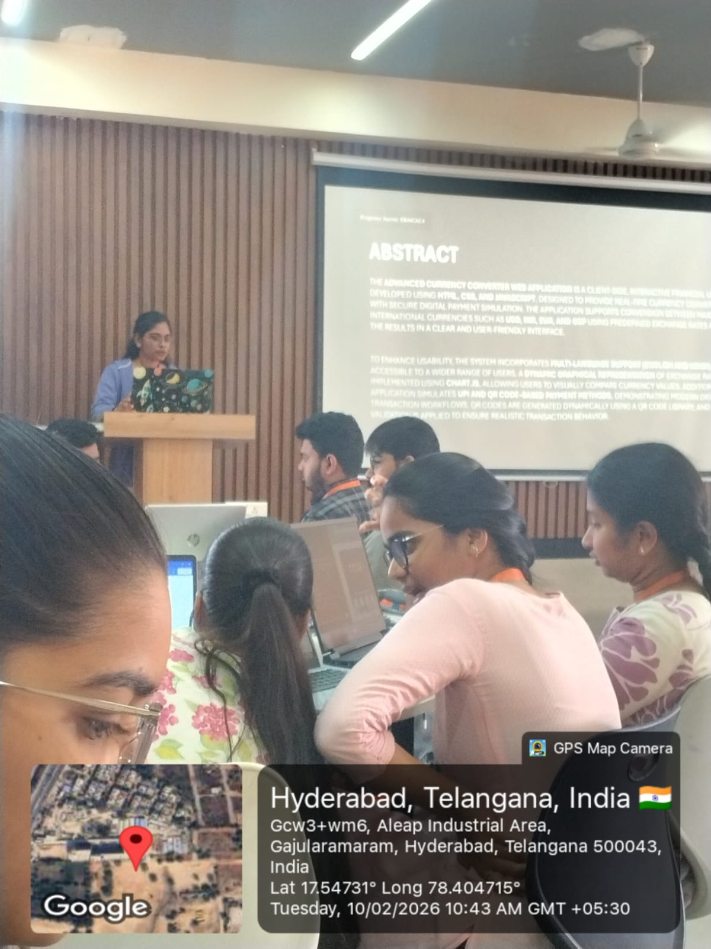
Geo- Tag Photos

Slide 13
THANK YOU

